Slide 1

Serverless On the Edge

Slide 2
Edge cluster

Slide 3
Serverless on K8s

Slide 4
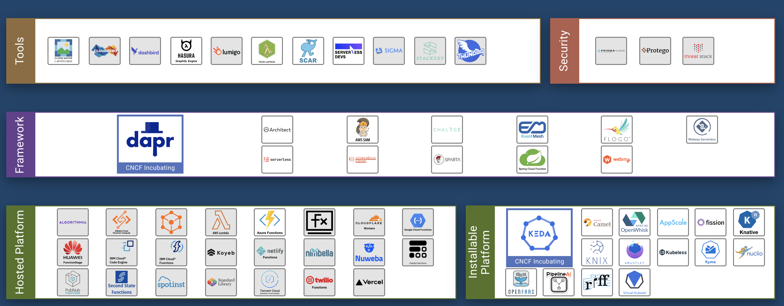
CNCF Serverless Landscape
https://landscape.cncf.io/serverless

Slide 5
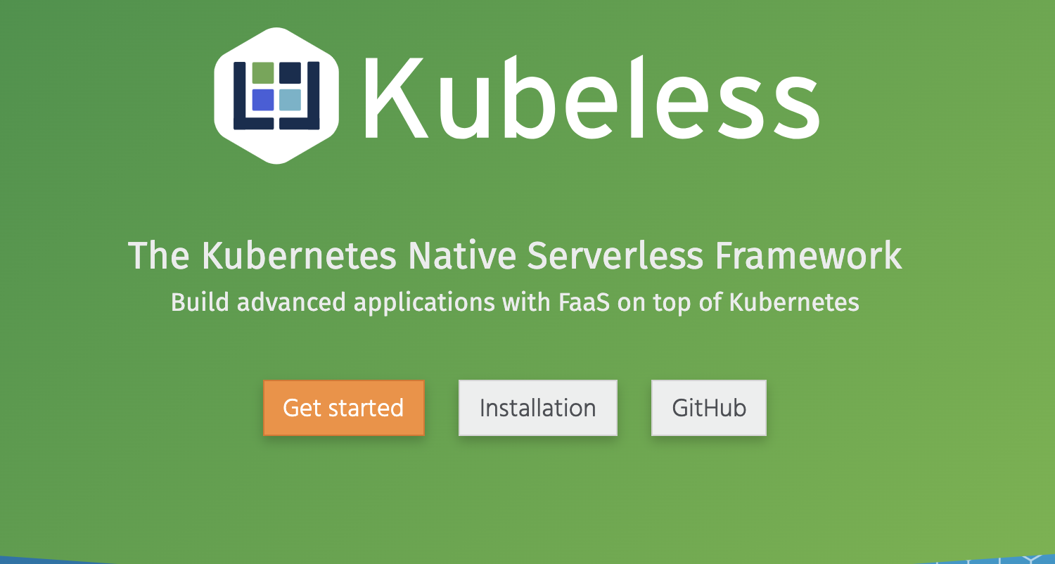
Kubeless

Slide 6
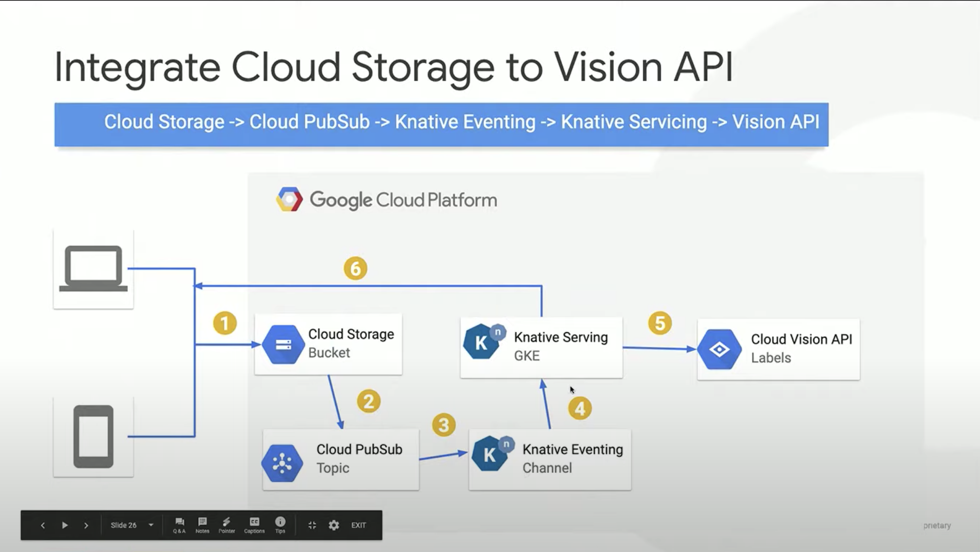
Knative
https://youtu.be/HiIJqMqFbC0

Slide 7
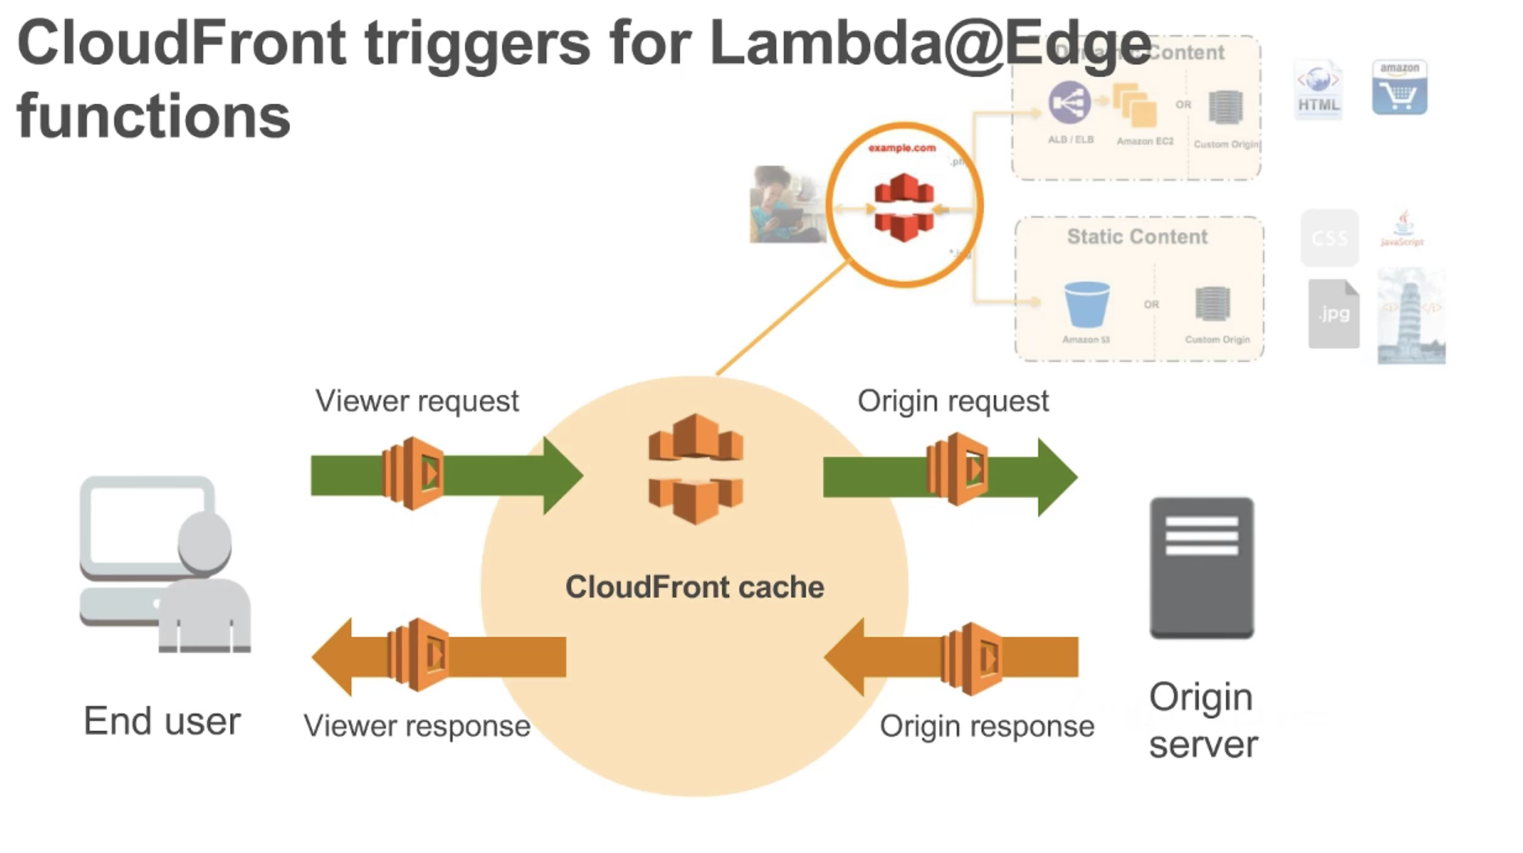
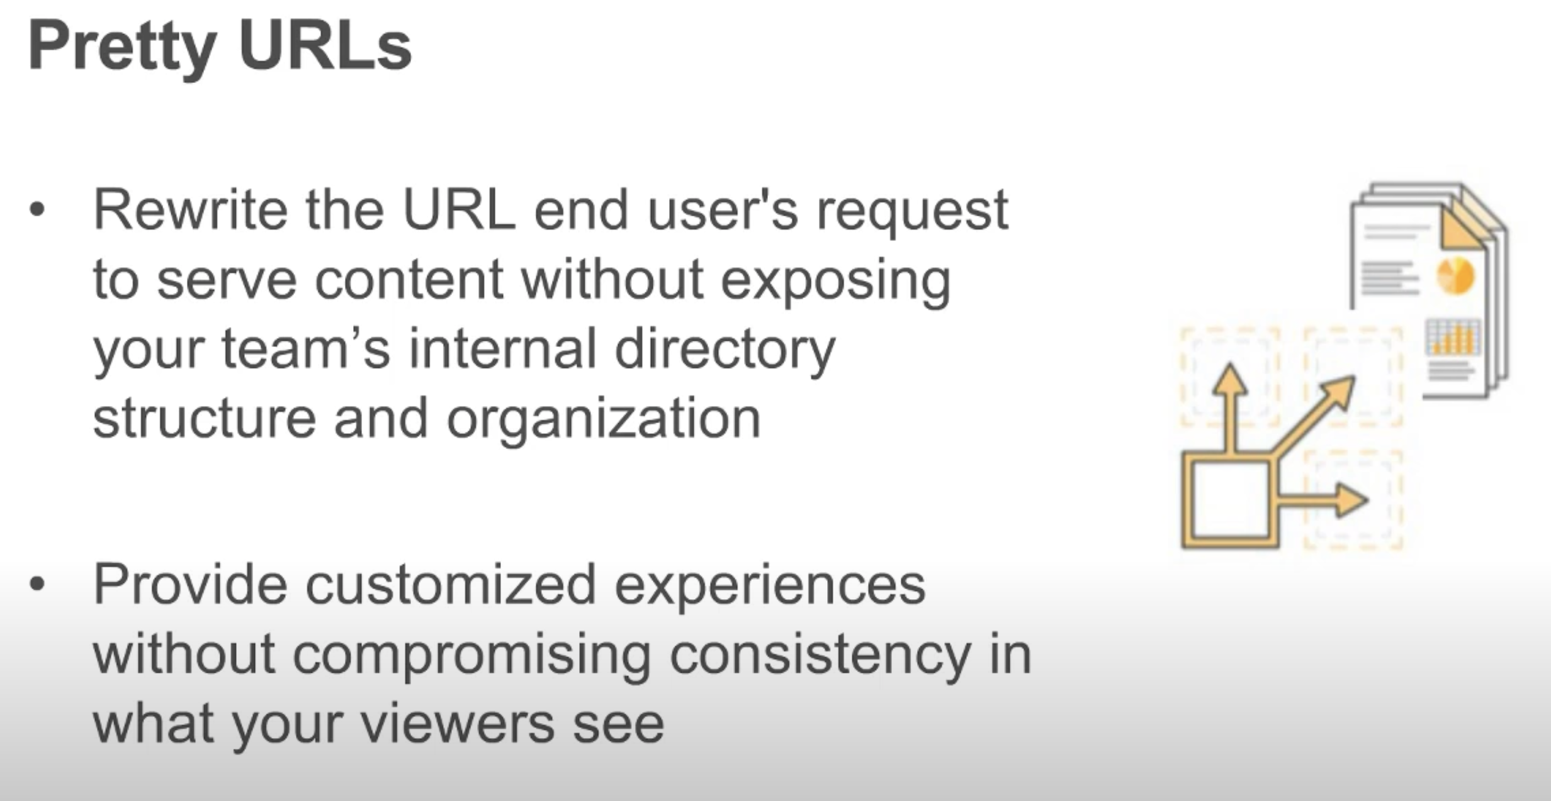
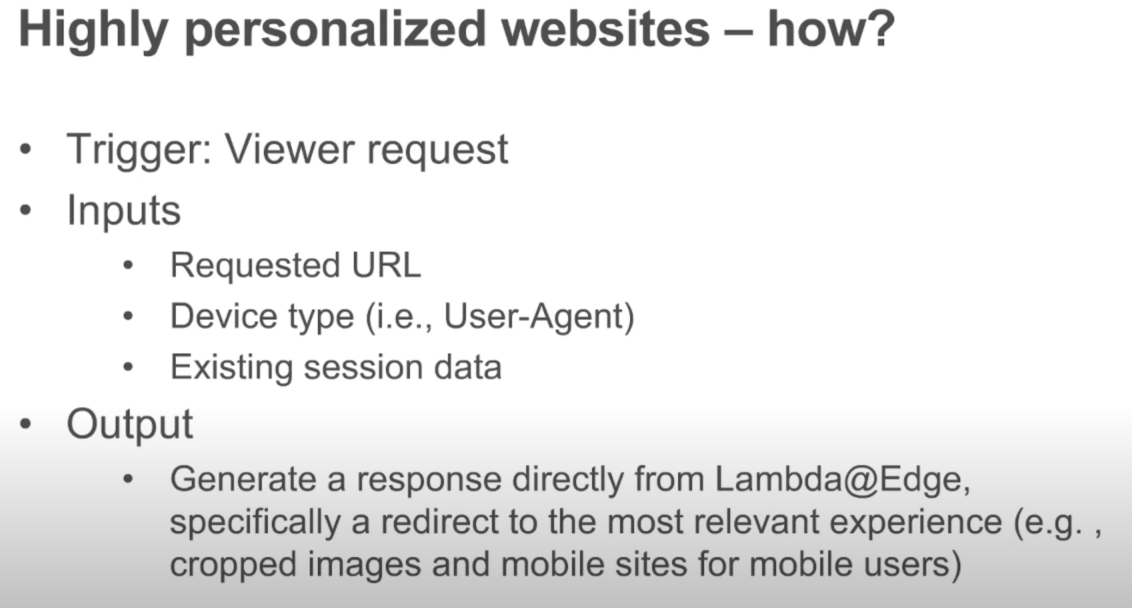
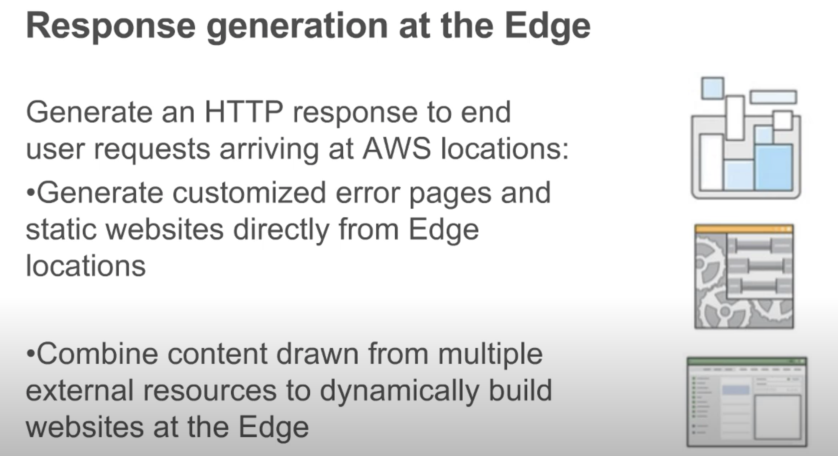
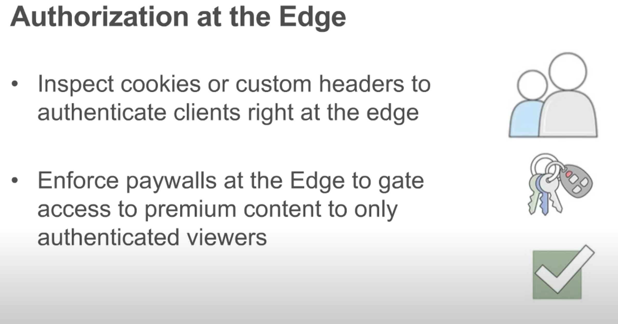
https://youtu.be/3O4JyyFcVIw

Slide 8
Edge Serverless Scenario

Slide 9

Edge
HTTP Get
fn
Cloud db
fn
fn
fn
fn

Slide 10
Cloud db
fn
fn
fn

Slide 11
Data upload
Edge db
eventing
fn
fn
fn

Slide 12
Edge db
Cloud db
fn
fn
fn

Slide 13


Slide 14
Edge Serverless Runtime

Slide 15
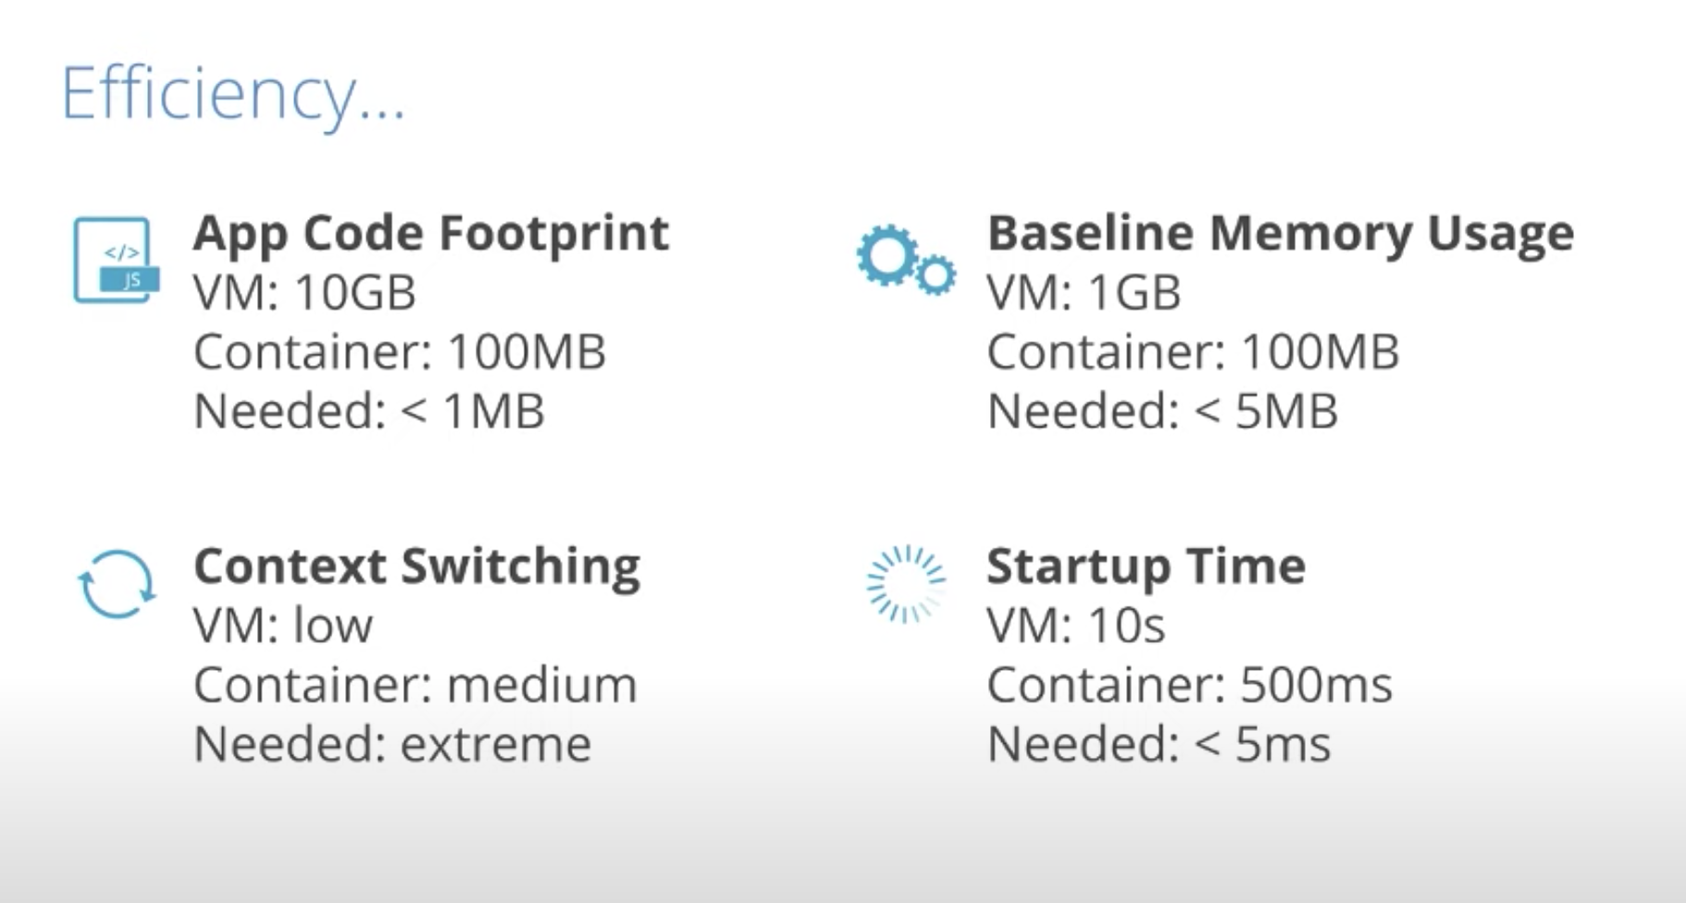
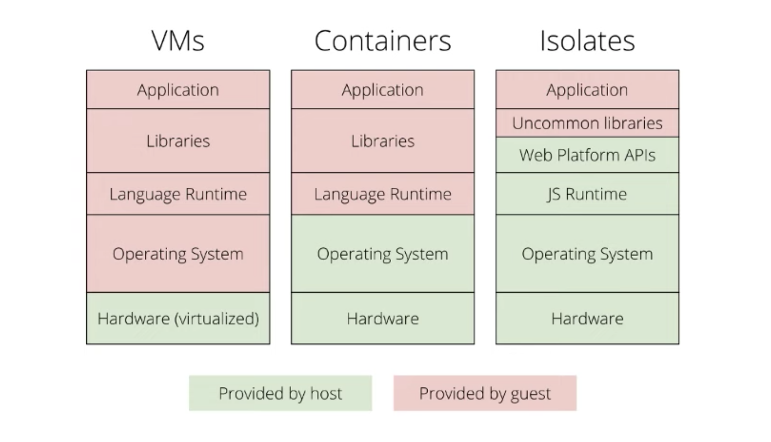
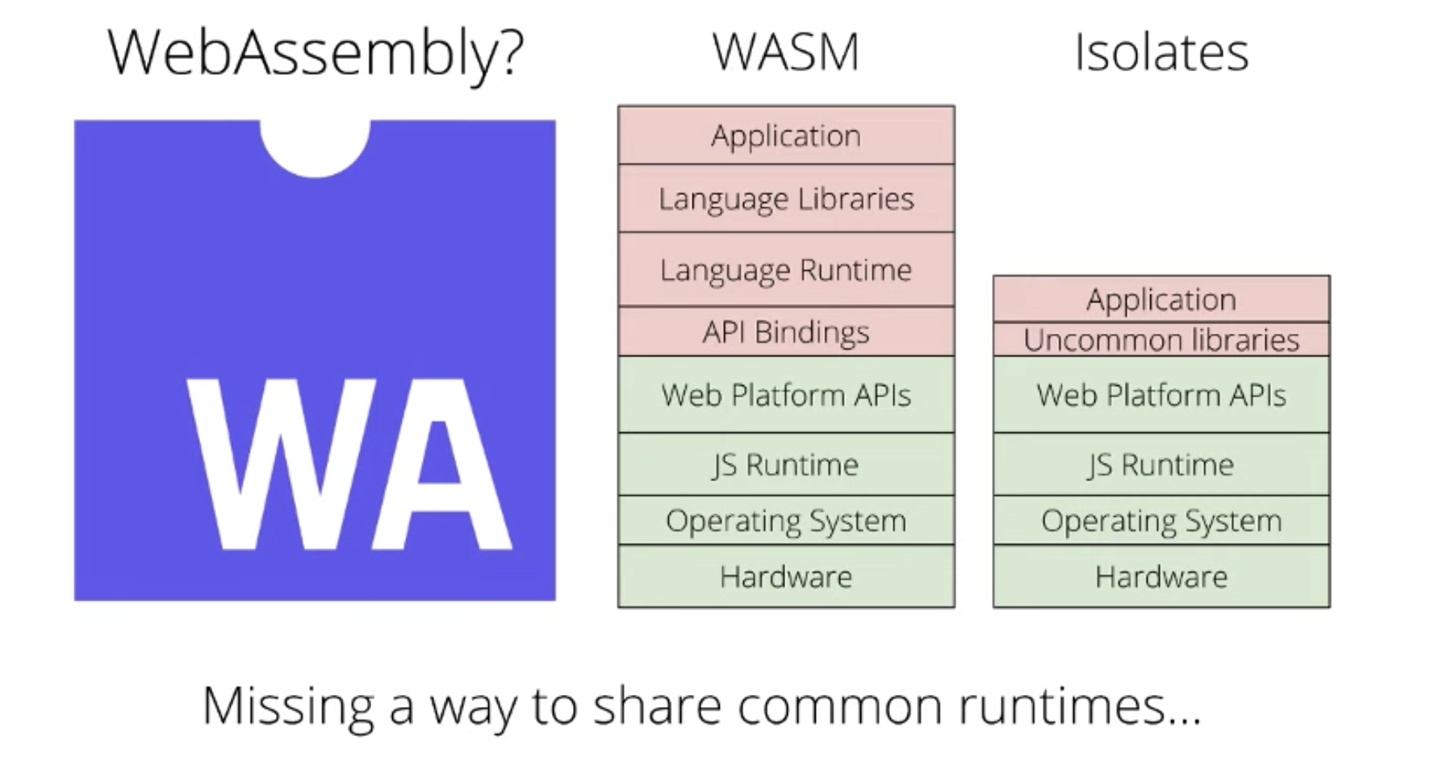
https://youtu.be/HK04UxENH10

Slide 16
WASM > Container
Cold start
Resource isolation (“Software Fault Isolation”)
Resource footprint
Container > WASM
“stateful” application
Language support
OS access
Management & orchestration tools

Slide 17
WASM
Unlike system VMs and containers, WebAssembly is a high-level language VM runtime
WebAssembly runtime provides a Software-based Fault Isolation (SFI) sandbox for untrusted code
WebAssembly supports multiple programming languages, such as C/C++ and Rust. The WebAssembly System Interface (WASI) standard [14] allows WebAssembly runtimes to interface with operating system resources, which makes it suitable for server-side applications.
WebAssembly functions can run securely and in isolation. Those functions can be started and stopped on-demand across different underlying platforms without any code change.

Slide 18
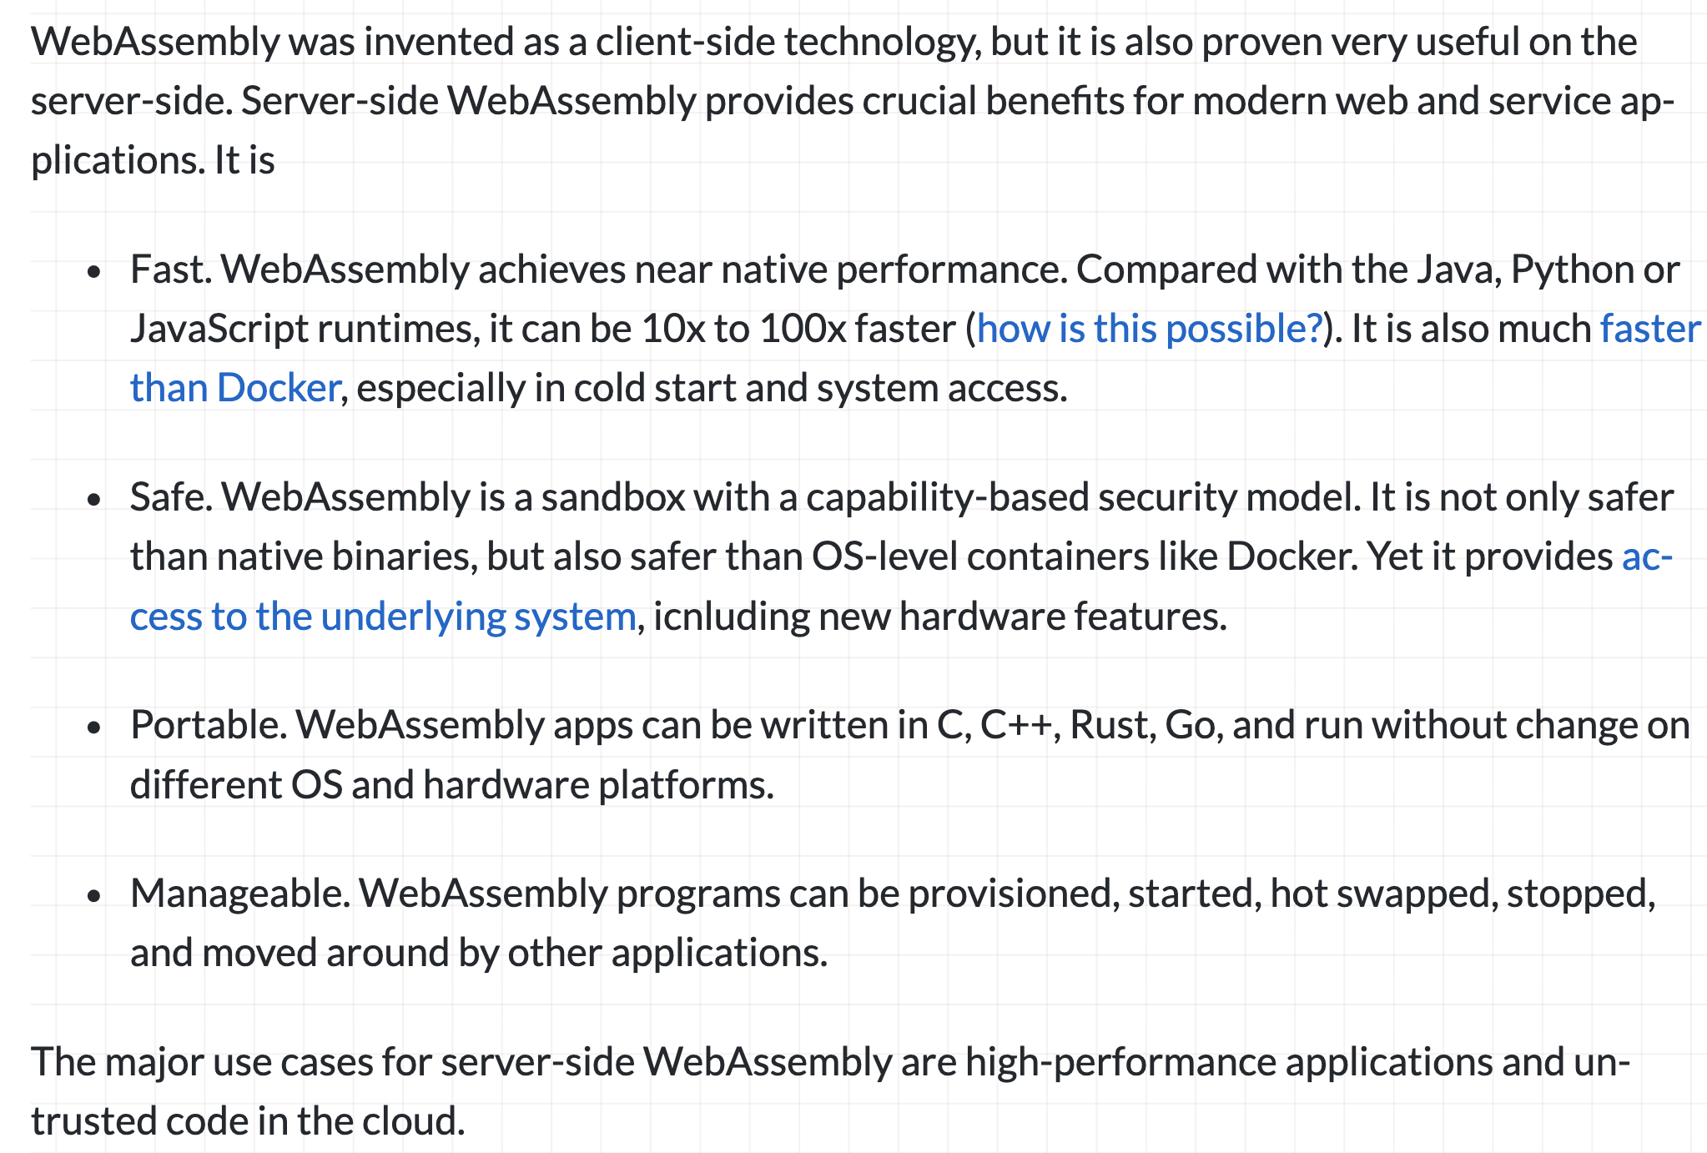
WASM
https://www.secondstate.io/articles/why-webassembly-server

Slide 19
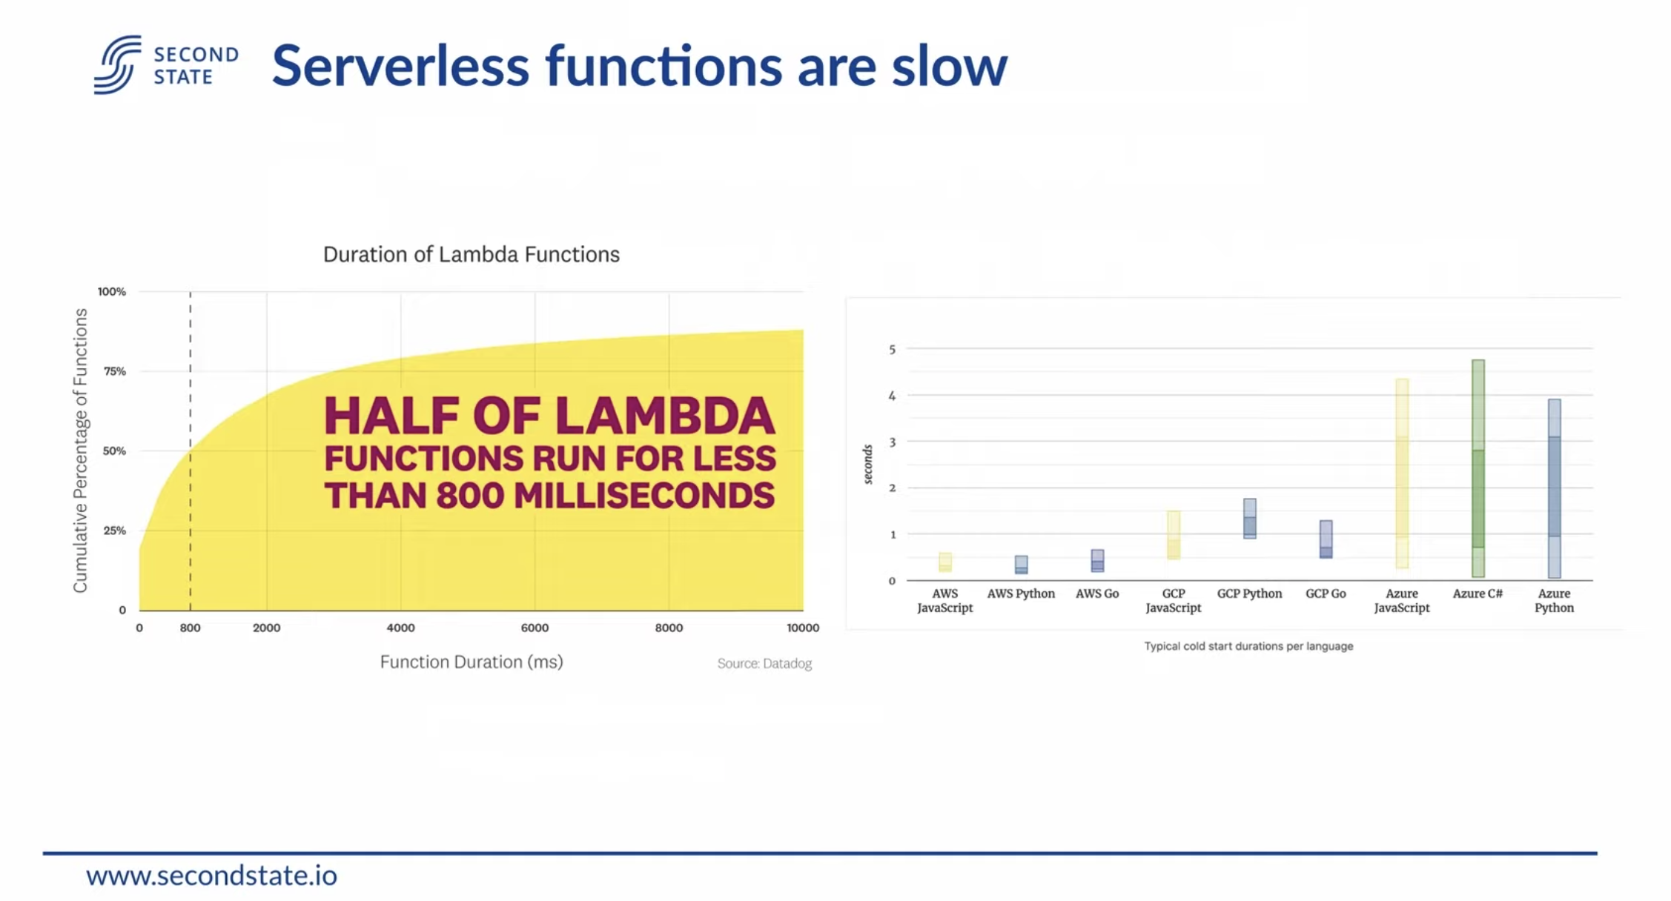
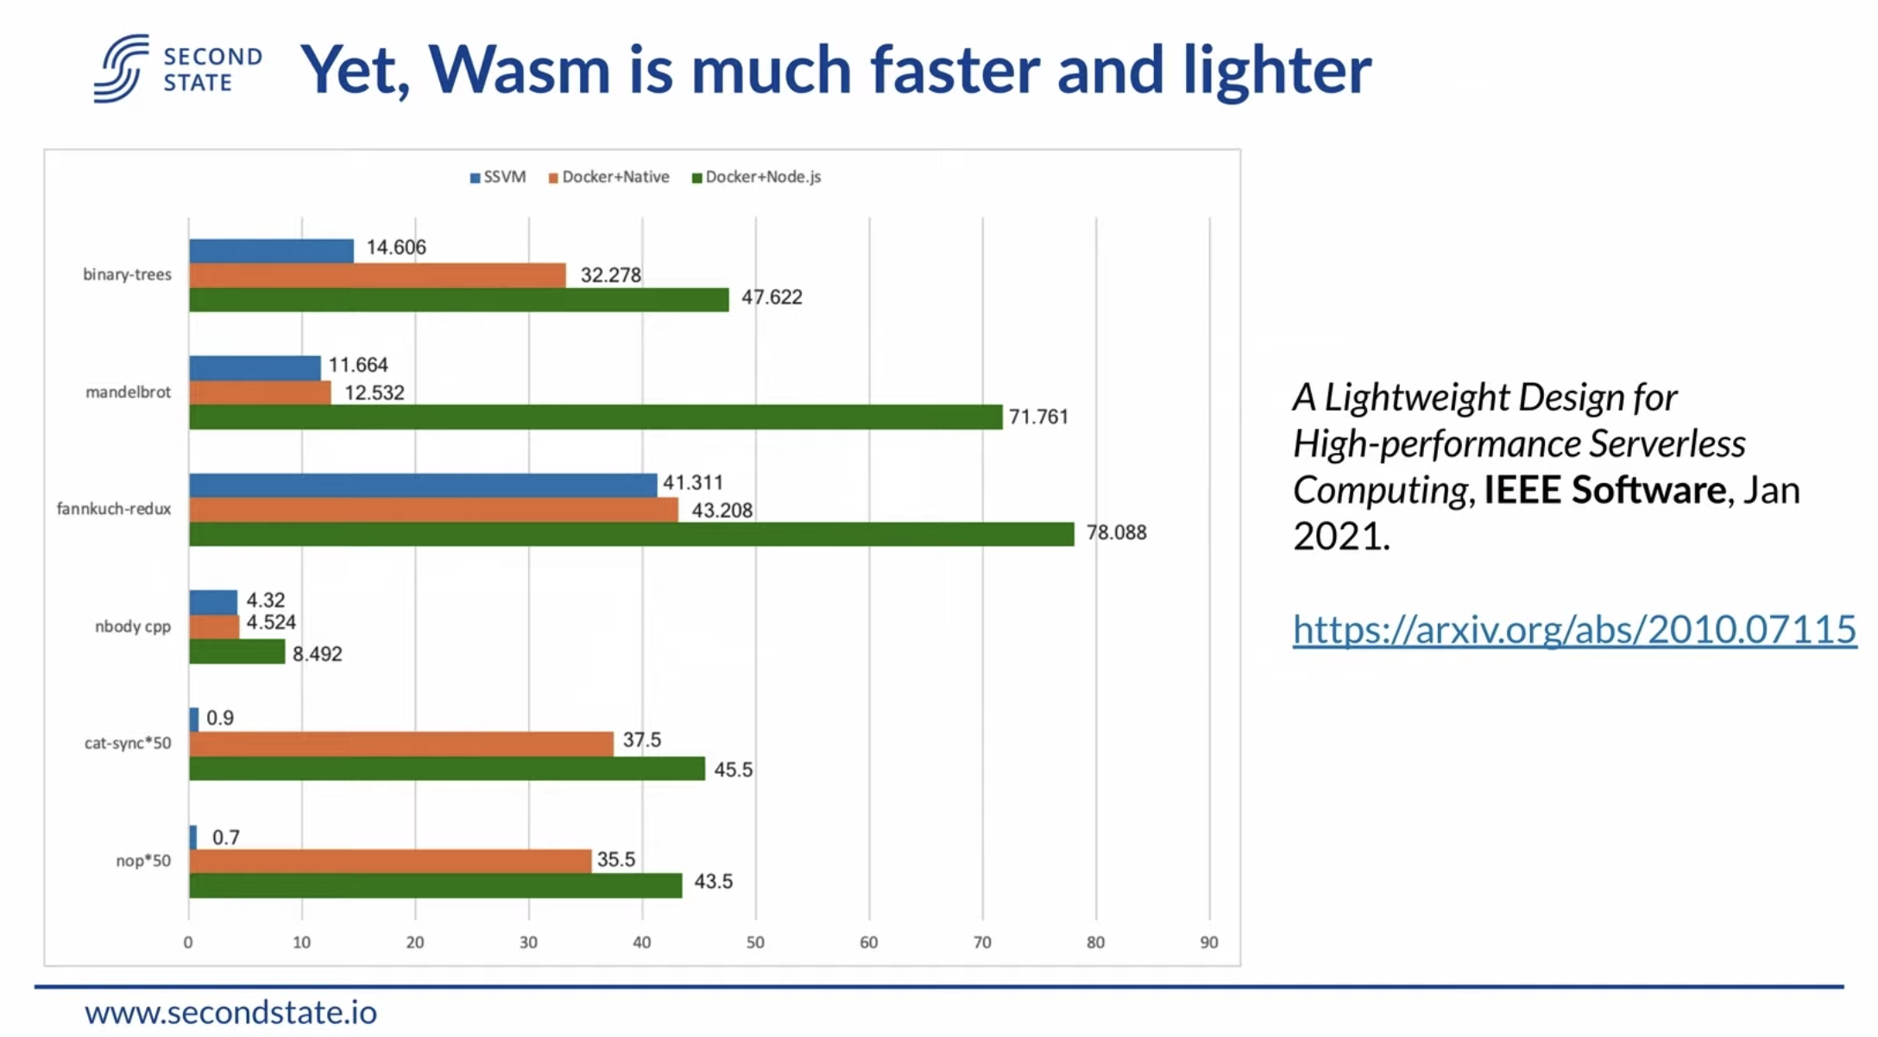
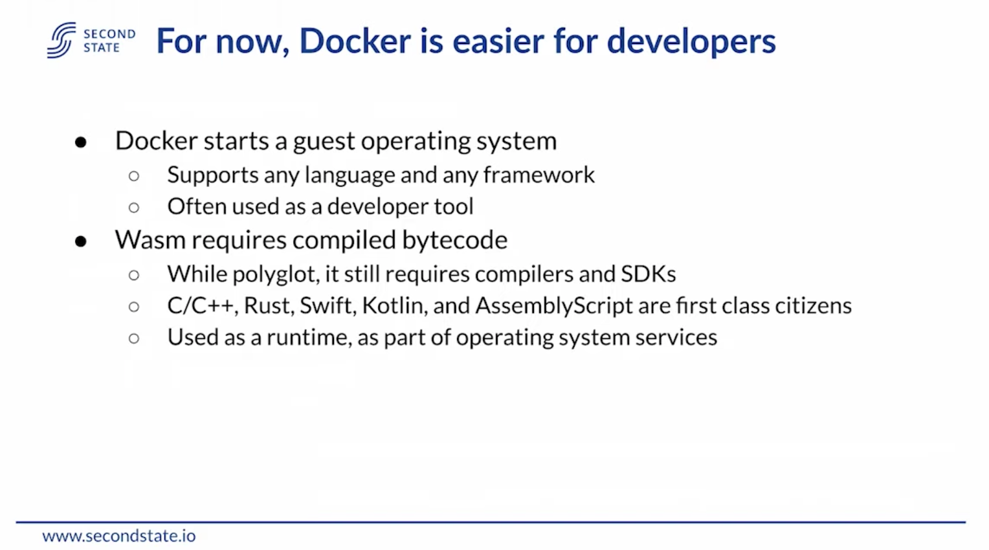
https://youtu.be/1oHE6x5fI0E

Slide 20
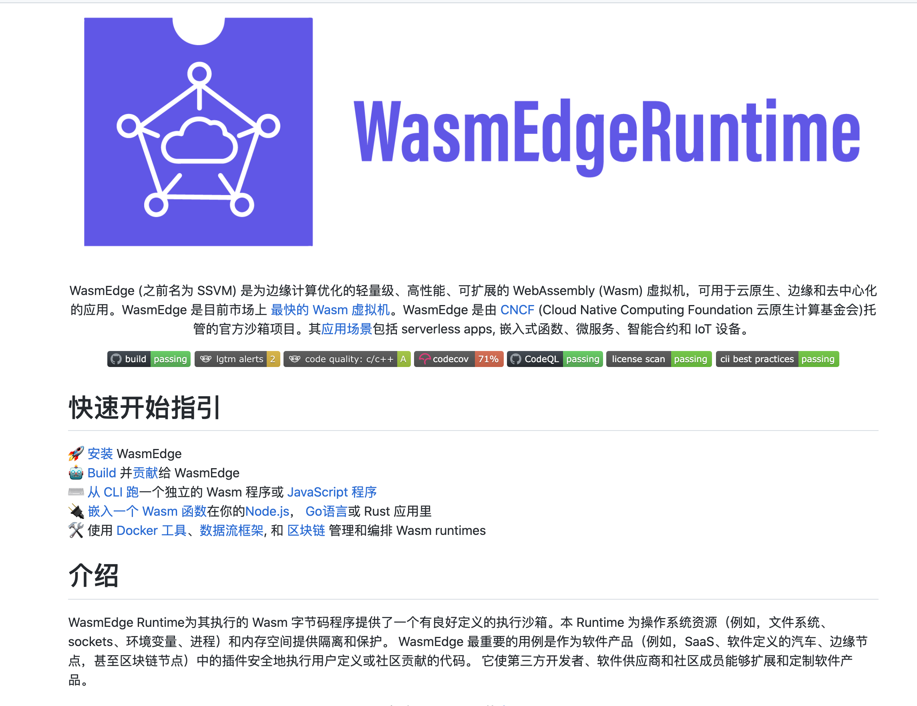
https://github.com/WasmEdge/WasmEdge

Slide 21
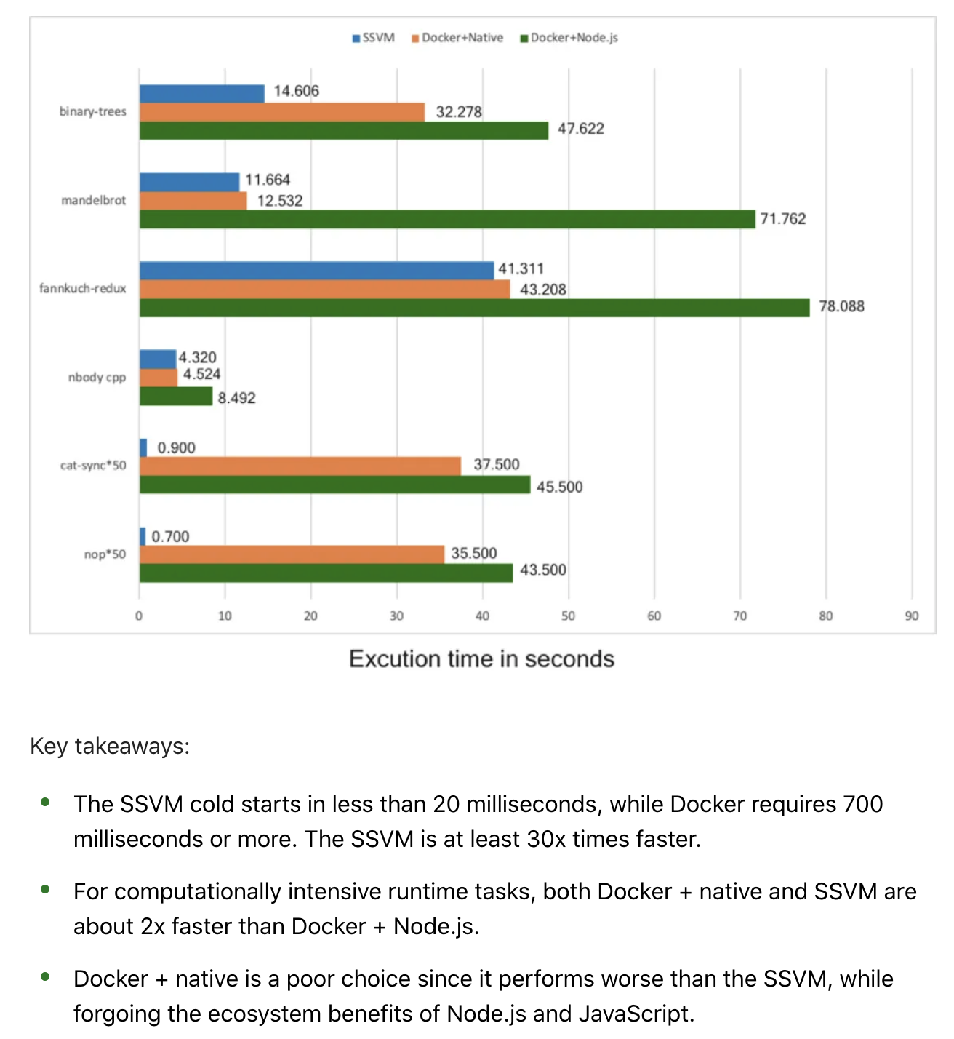
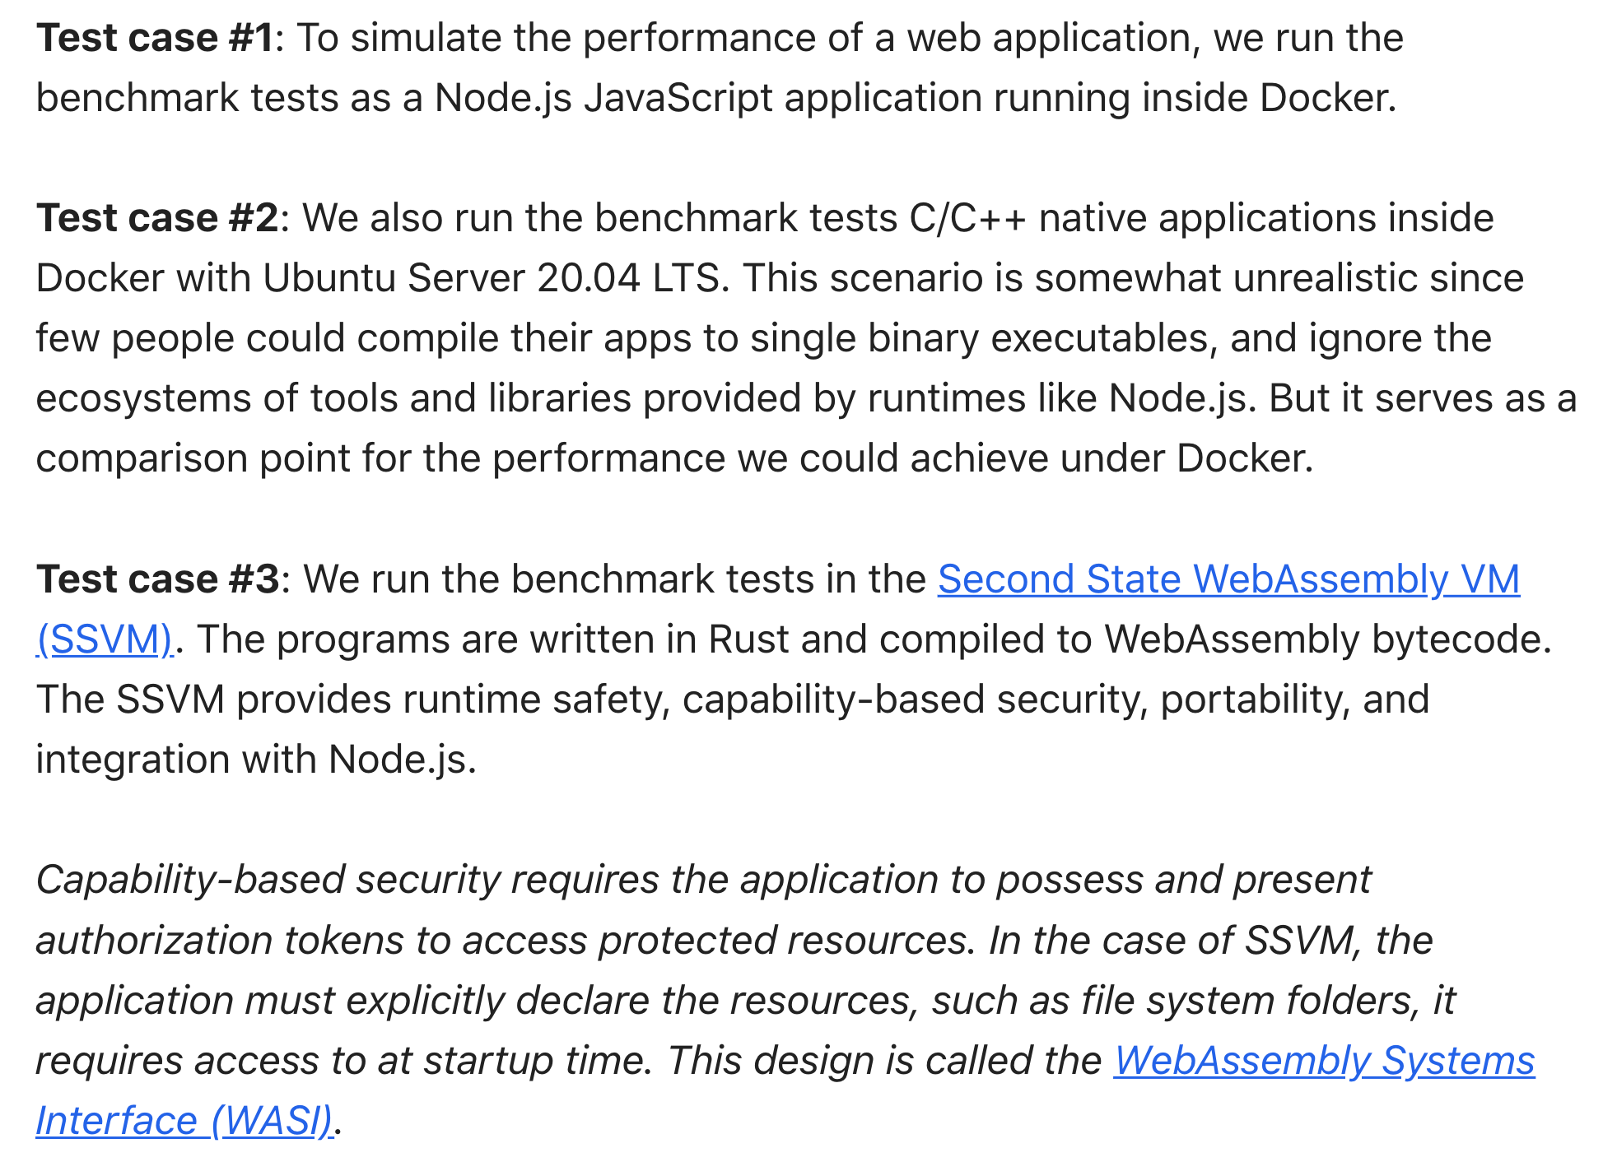
Benchmark: cold start
https://www.infoq.com/articles/arm-vs-x86-cloud-performance

Slide 22
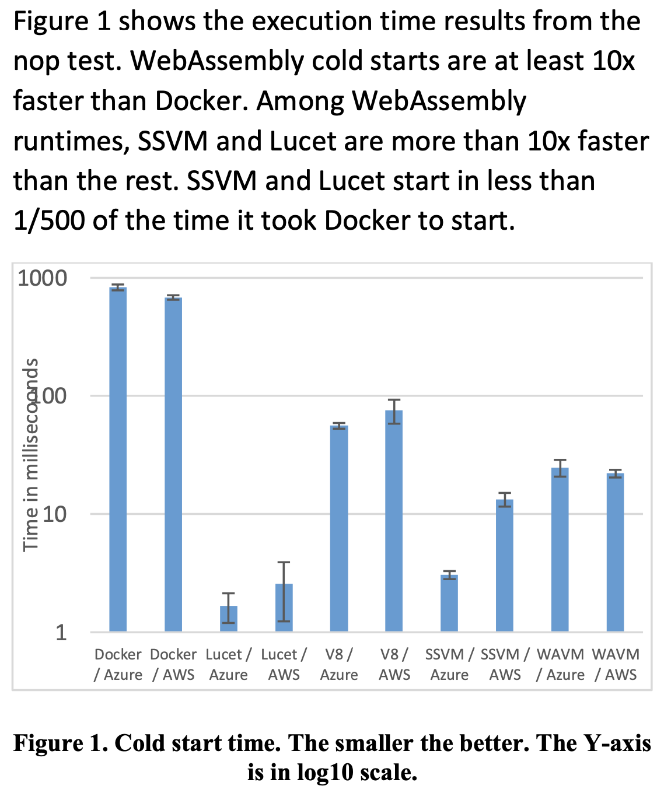
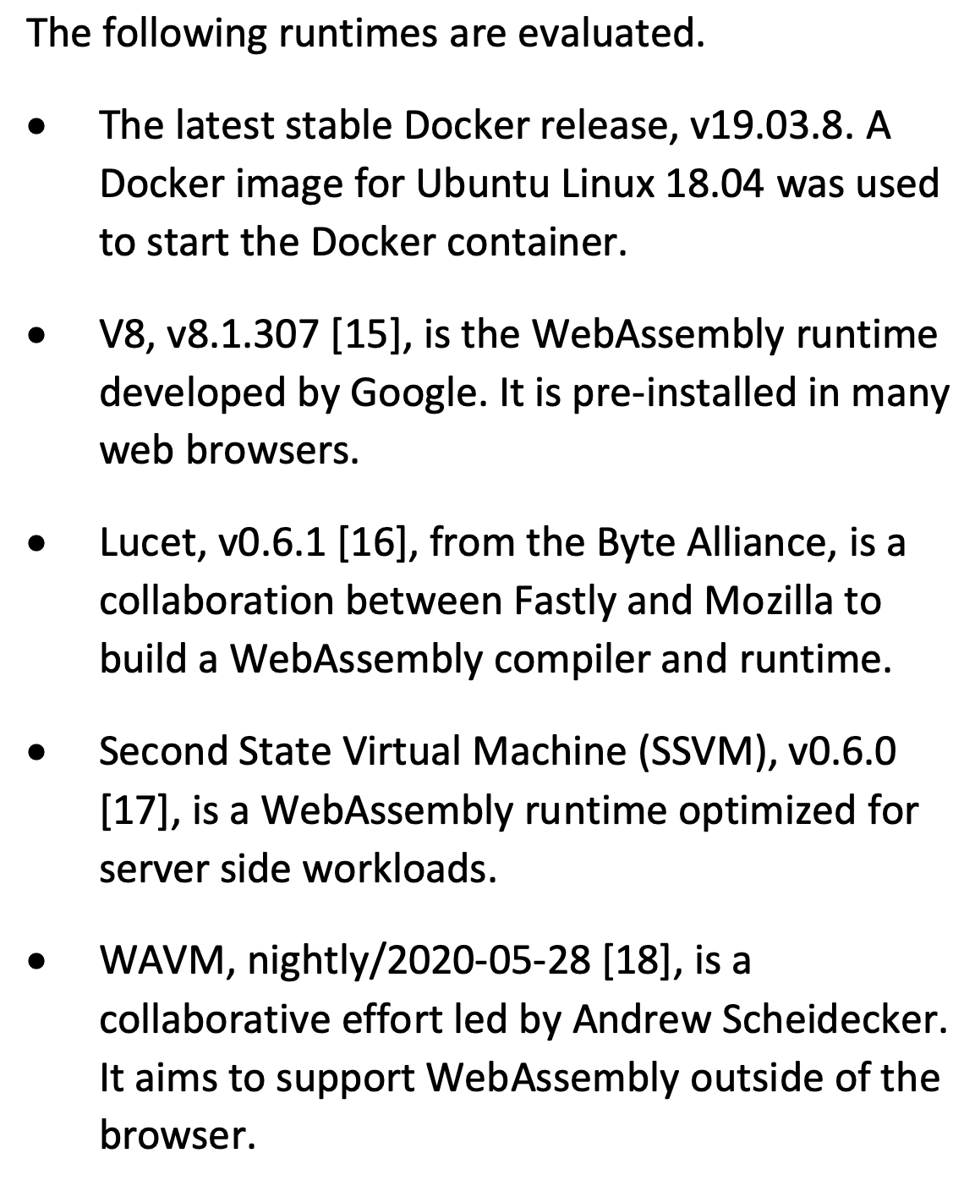
Benchmark: cold start
The nop test starts the runtime and exits. It evaluates cold start performance
“A lightweight design for serverless Function-as-a-Service”

Slide 23
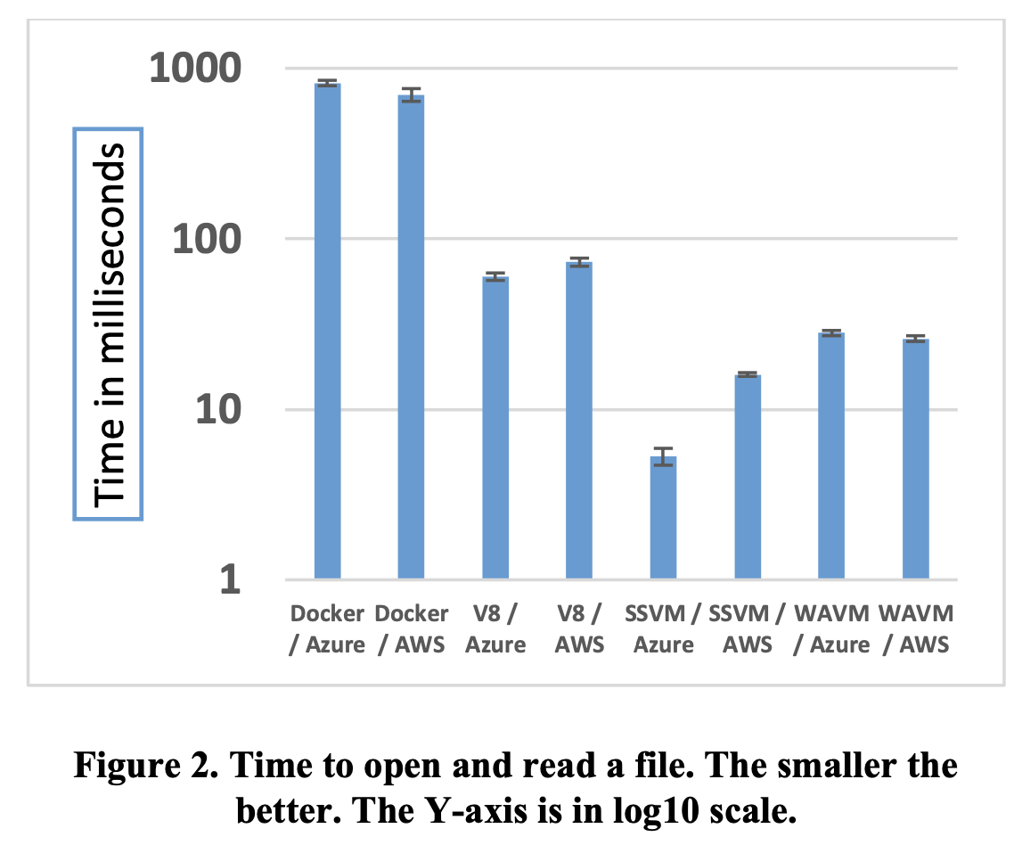
Benchmark: file I/O
The nop test starts the runtime and exits. It evaluates cold start performance
“A lightweight design for serverless Function-as-a-Service”

Slide 24
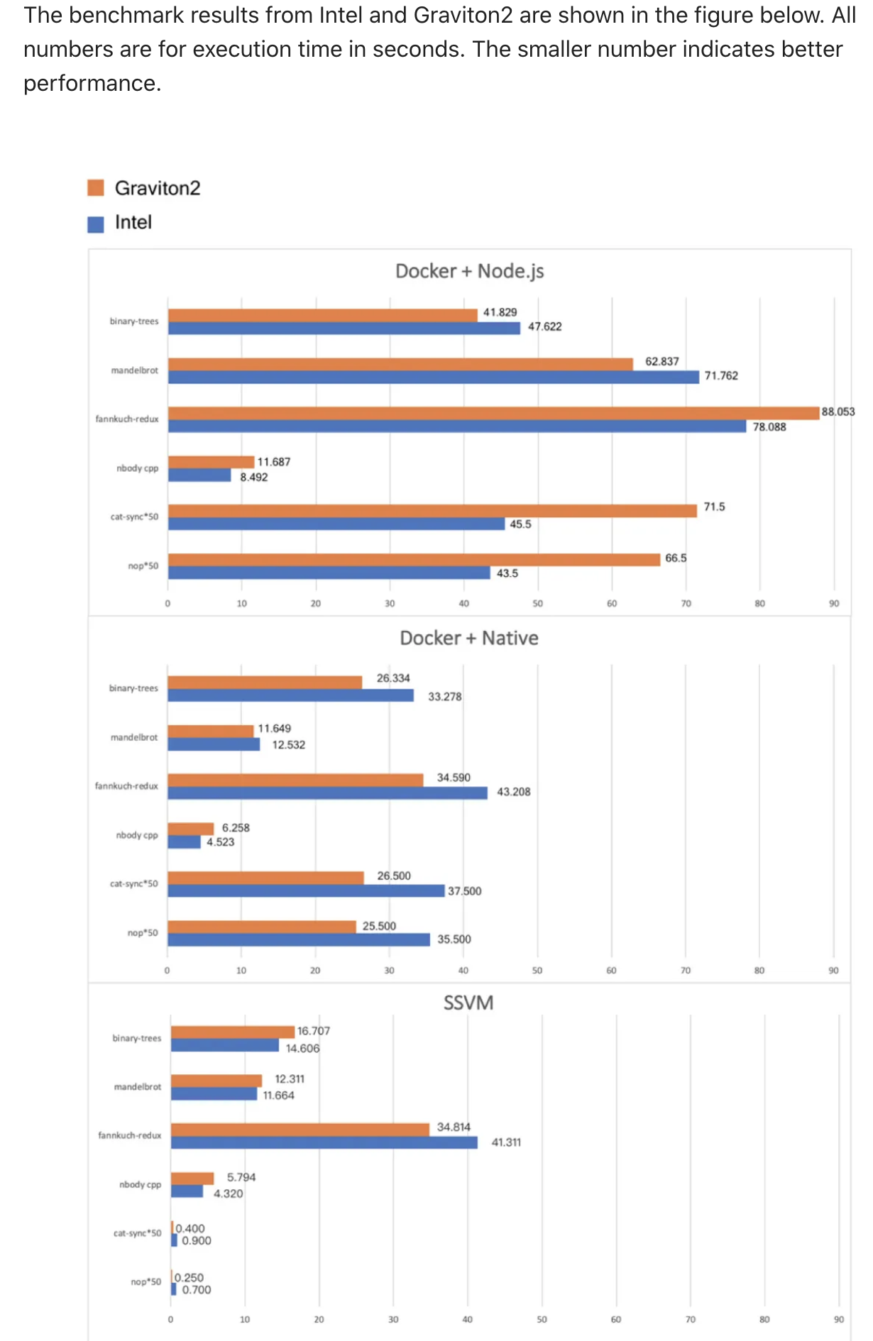
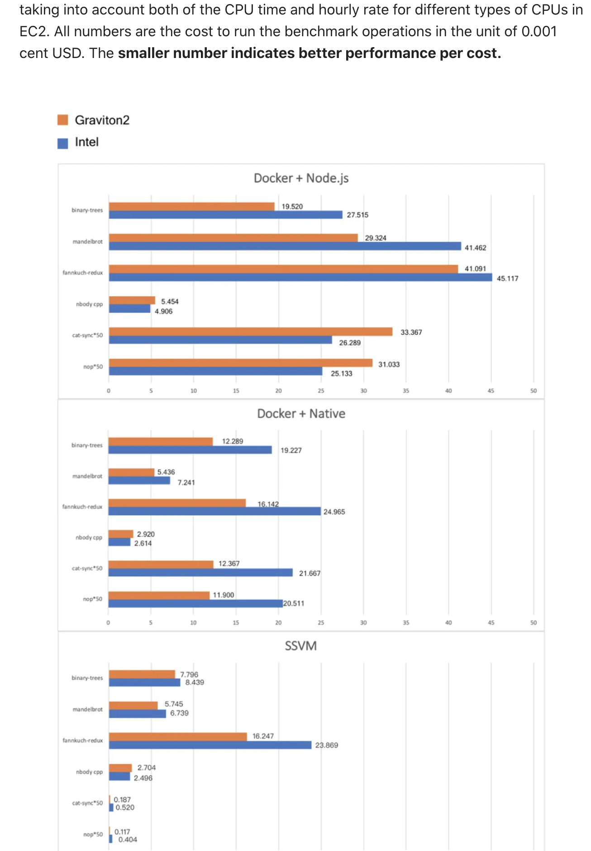
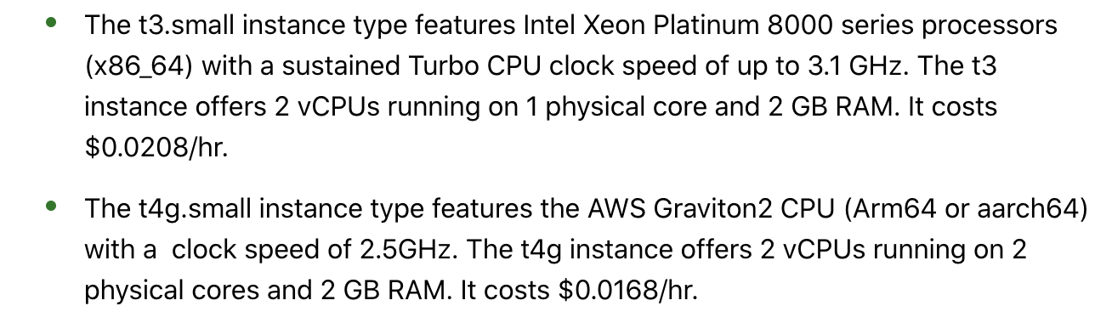
Benchmark: foot-print
Execution time
Execution cost
https://www.infoq.com/articles/arm-vs-x86-cloud-performance

Slide 25
Challenges
Limited programming language support: While the LLVM toolchain supports generating WebAssembly bytecode from 20+ languages, only a handful of languages are well supported in practice. Currently, C/C++, Rust, and AssemblyScript are the best supported programming languages for WebAssembly
Access to OS: System features , such as networking and multithread management (Multithreaded I/O), are just becoming available to WebAssembly.
Standard: no industry standard management and orchestration tools for WebAssembly runtimes
“A lightweight design for serverless Function-as-a-Service”

Slide 26
Cloud Serverless vs Edge Serverless
invoke
invoke

Slide 27
Stateful (Edge)Serverless

Slide 28
WASM is all good for logic but what about data?
Data access overheads are caused by the stateless nature of the container-based approach, which forces state to be maintained externally, e.g., in object stores such as Amazon S3, or passed between function invocations.
Both options incur costs due to duplicating data in each function, repeated serialization, and regular network transfers. This results in current applications adopting an inefficient “data-shipping architecture”, i.e., moving data to the computation and not vice versa—such architectures have been abandoned by the data management community many decades ago.
“Faasm: Lightweight Isolation for Efficient Stateful Serverless Computing”

Slide 29
Storage (Memory, Disk)

Slide 30
Data shipping
Data follows function
Co-locating functions
Function follows data

Slide 31
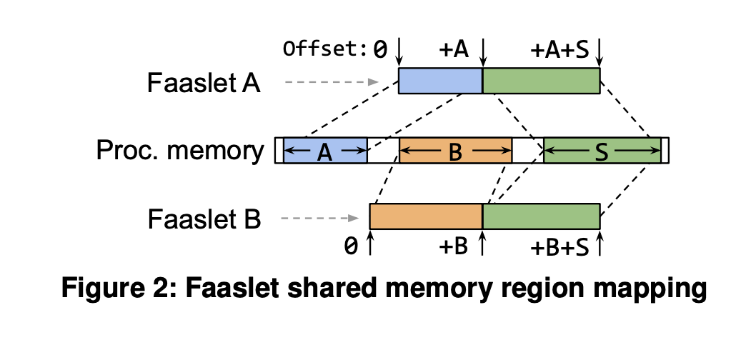
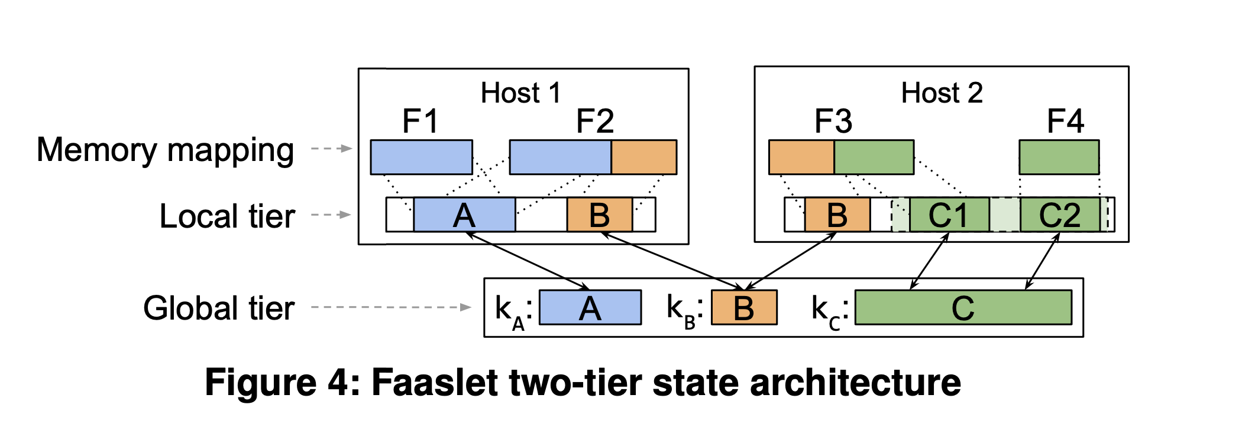
Sharing memory between functions
“Faasm: Lightweight Isolation for Efficient Stateful Serverless Computing”

Slide 32
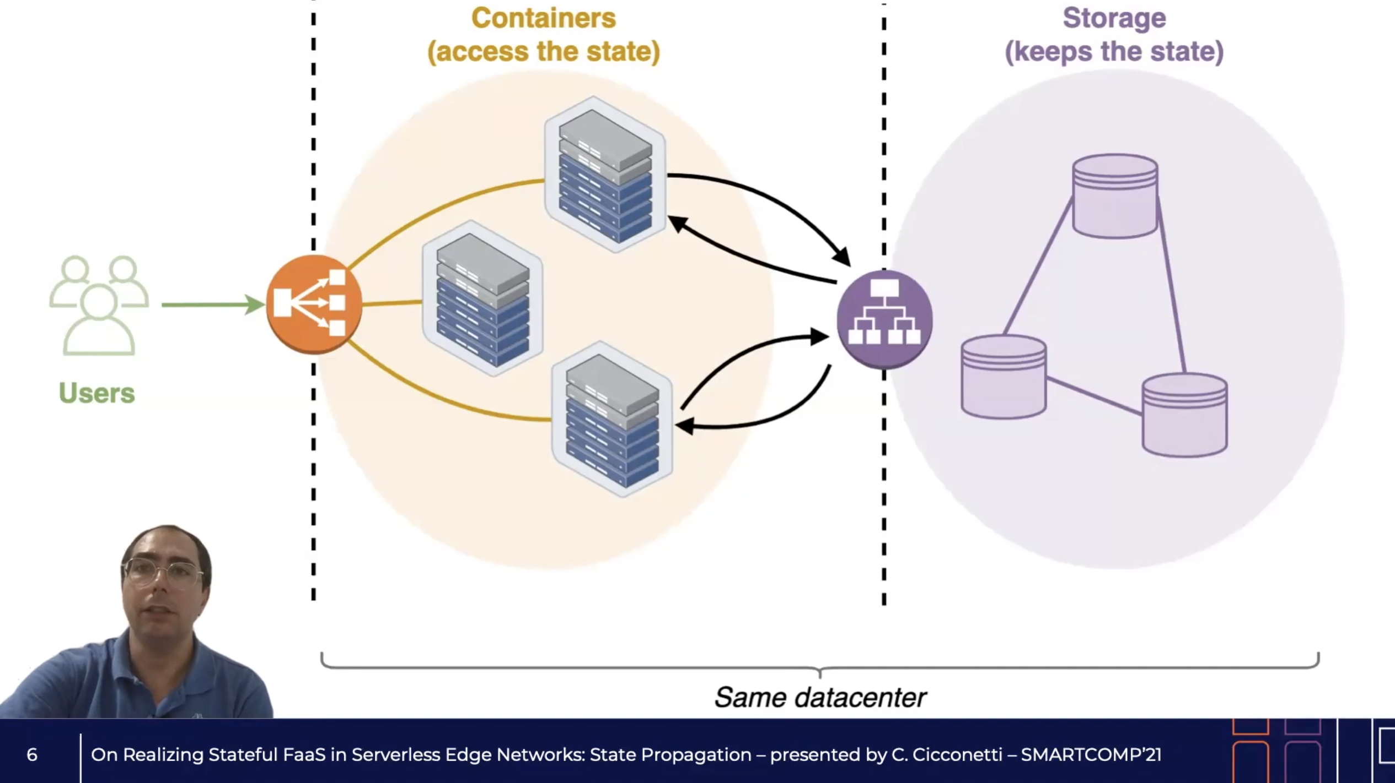
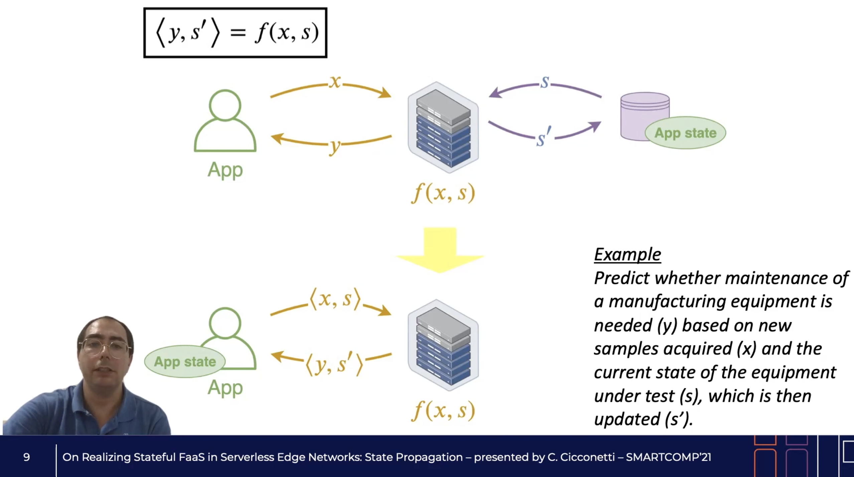
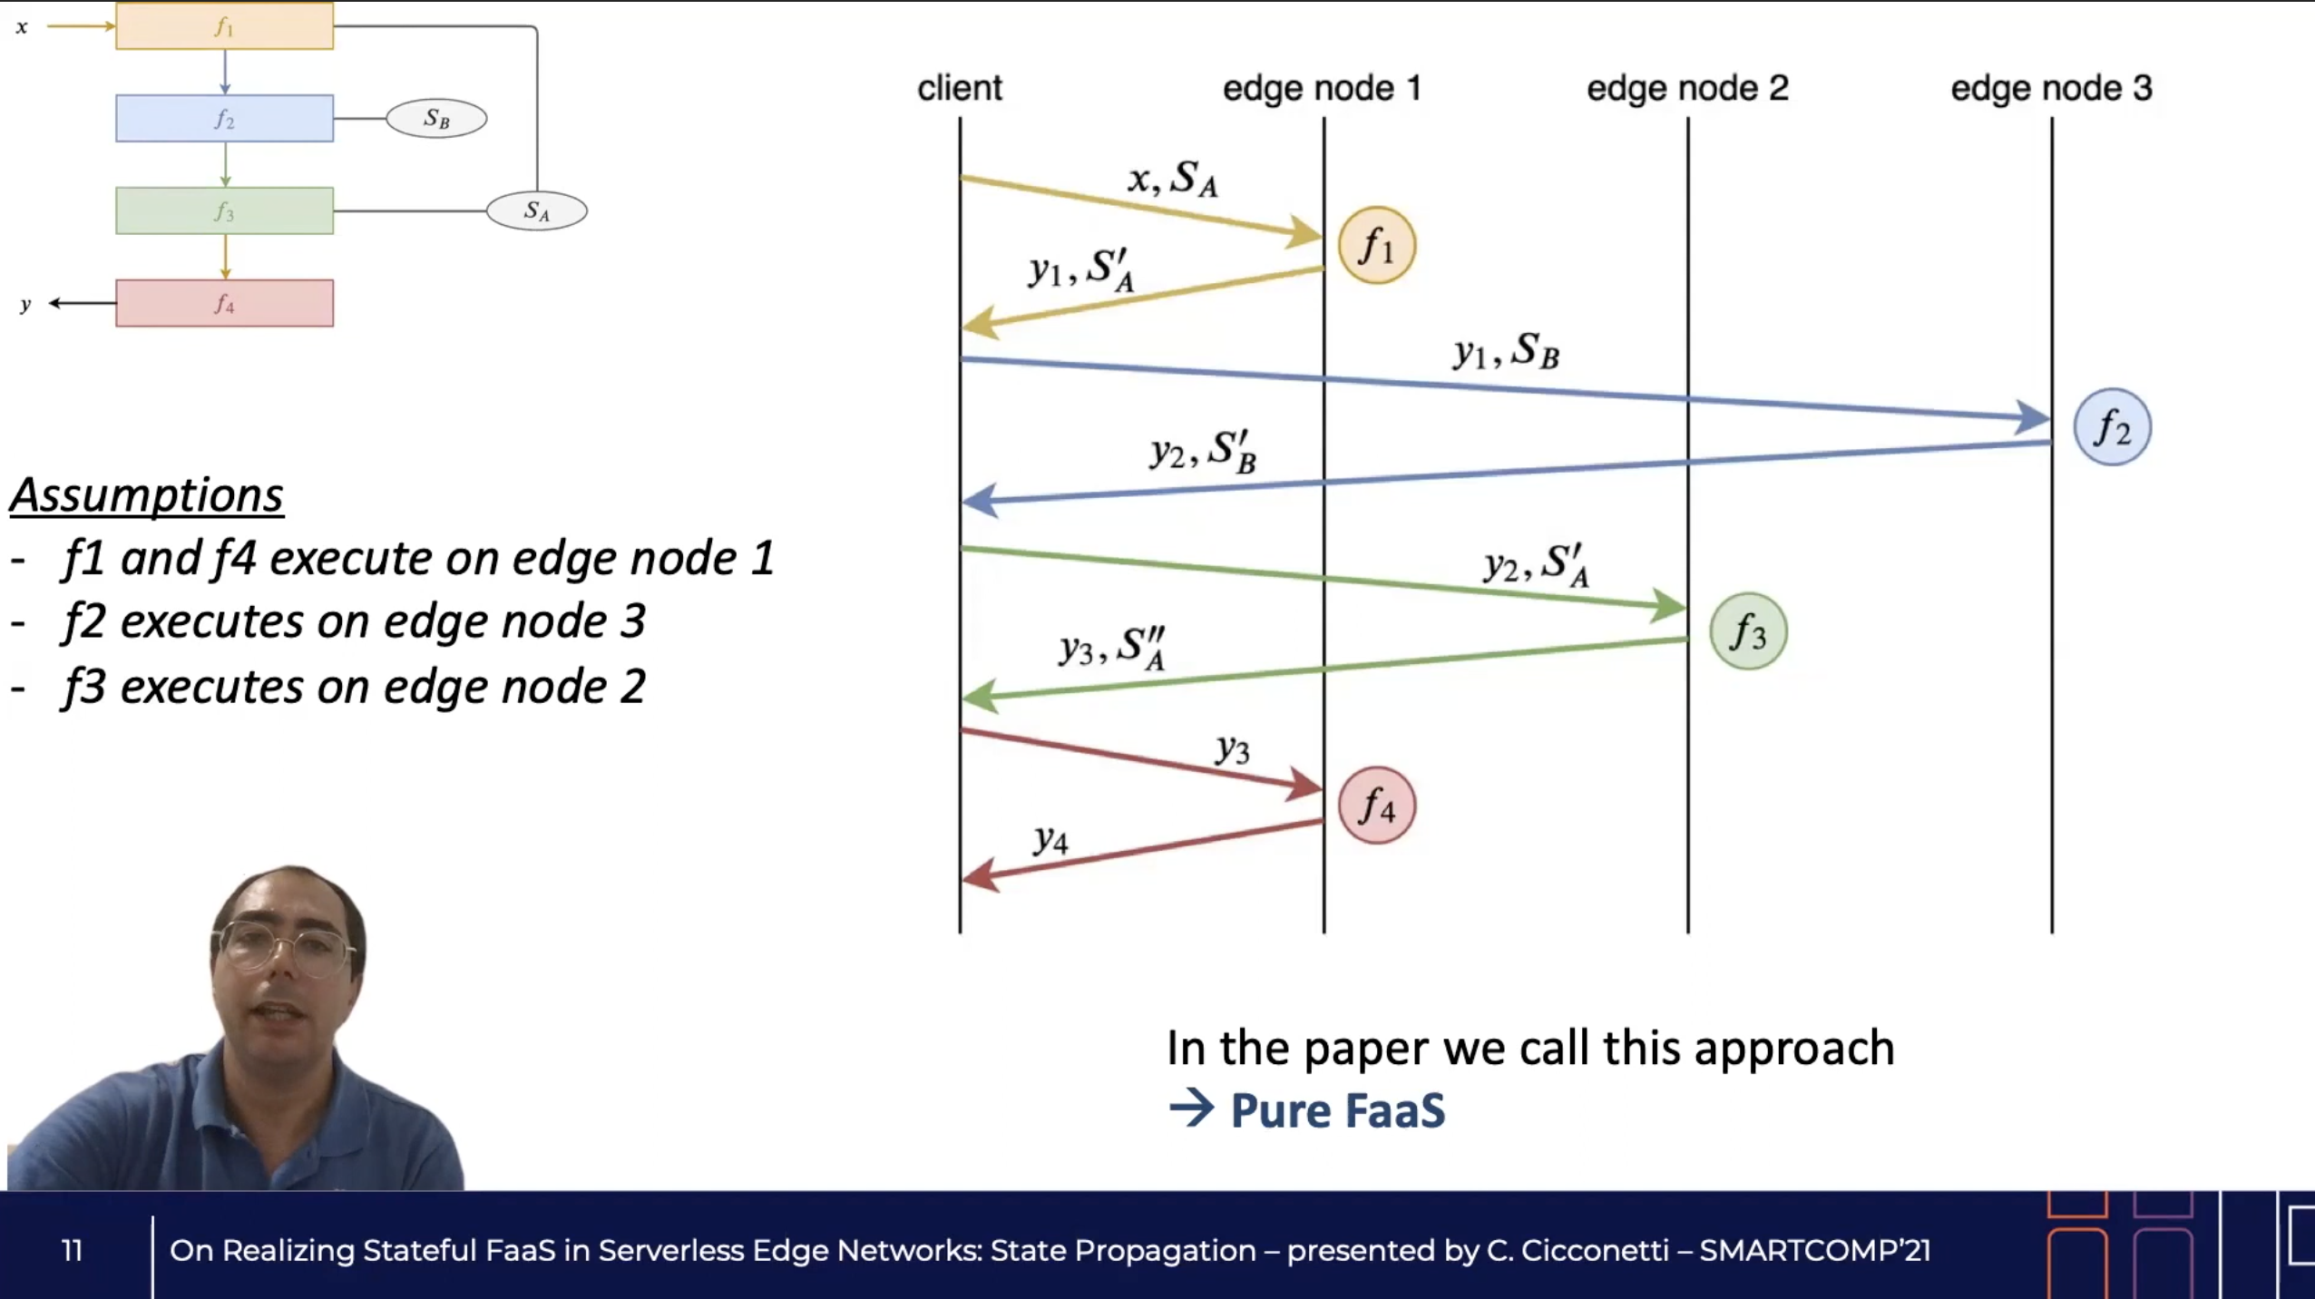
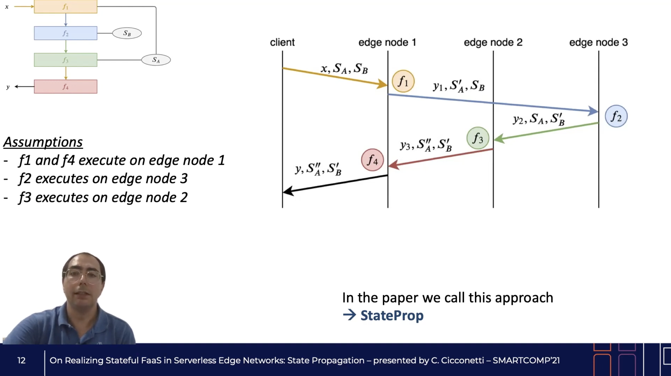
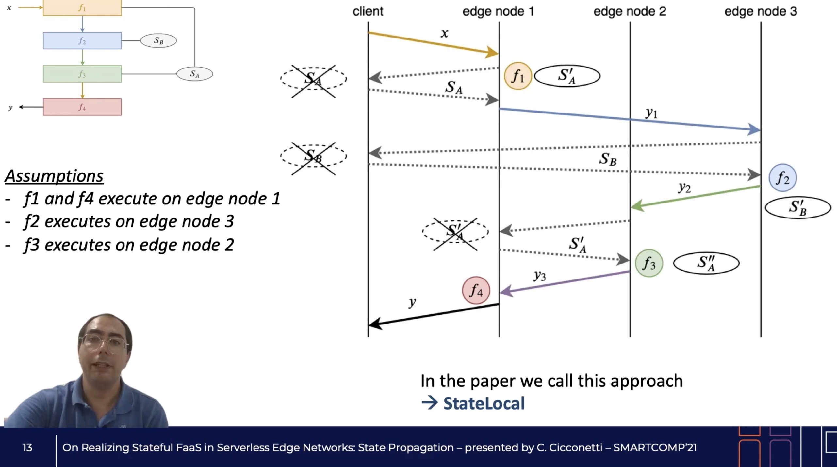
https://youtu.be/gc1pQ56UMAA
"On Realizing Stateful FaaS in Serverless Edge Networks:State Propagation"

Slide 33
https://youtu.be/gc1pQ56UMAA
"On Realizing Stateful FaaS in Serverless Edge Networks:State Propagation"

Slide 34
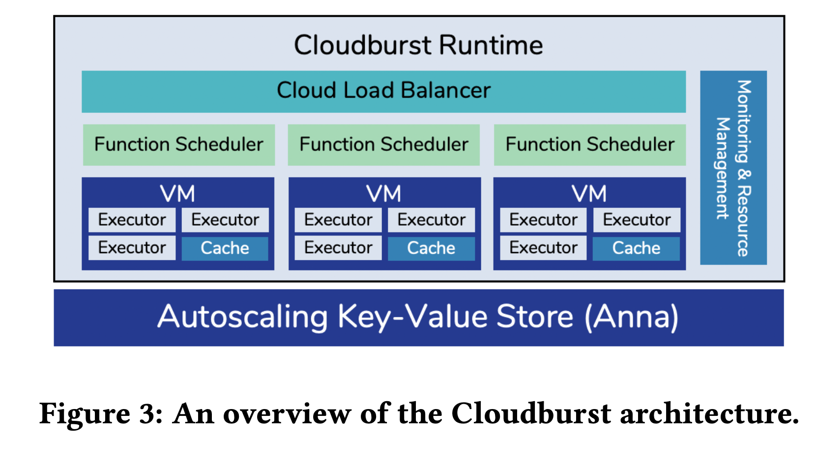
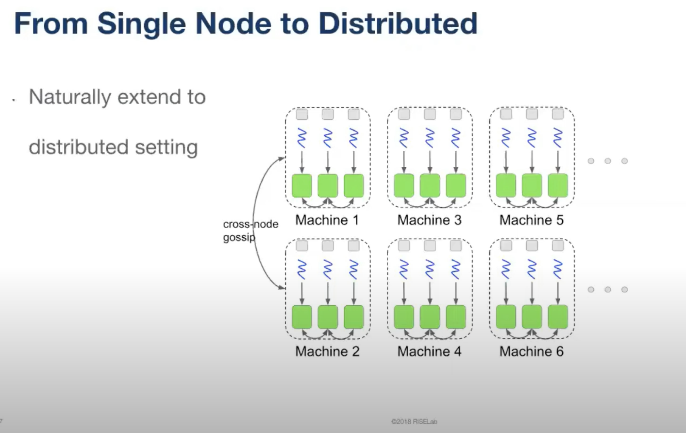
“Cloudburst - Stateful Functions-as-a-Service”
https://youtu.be/9qU1zO9wCNs

Slide 35
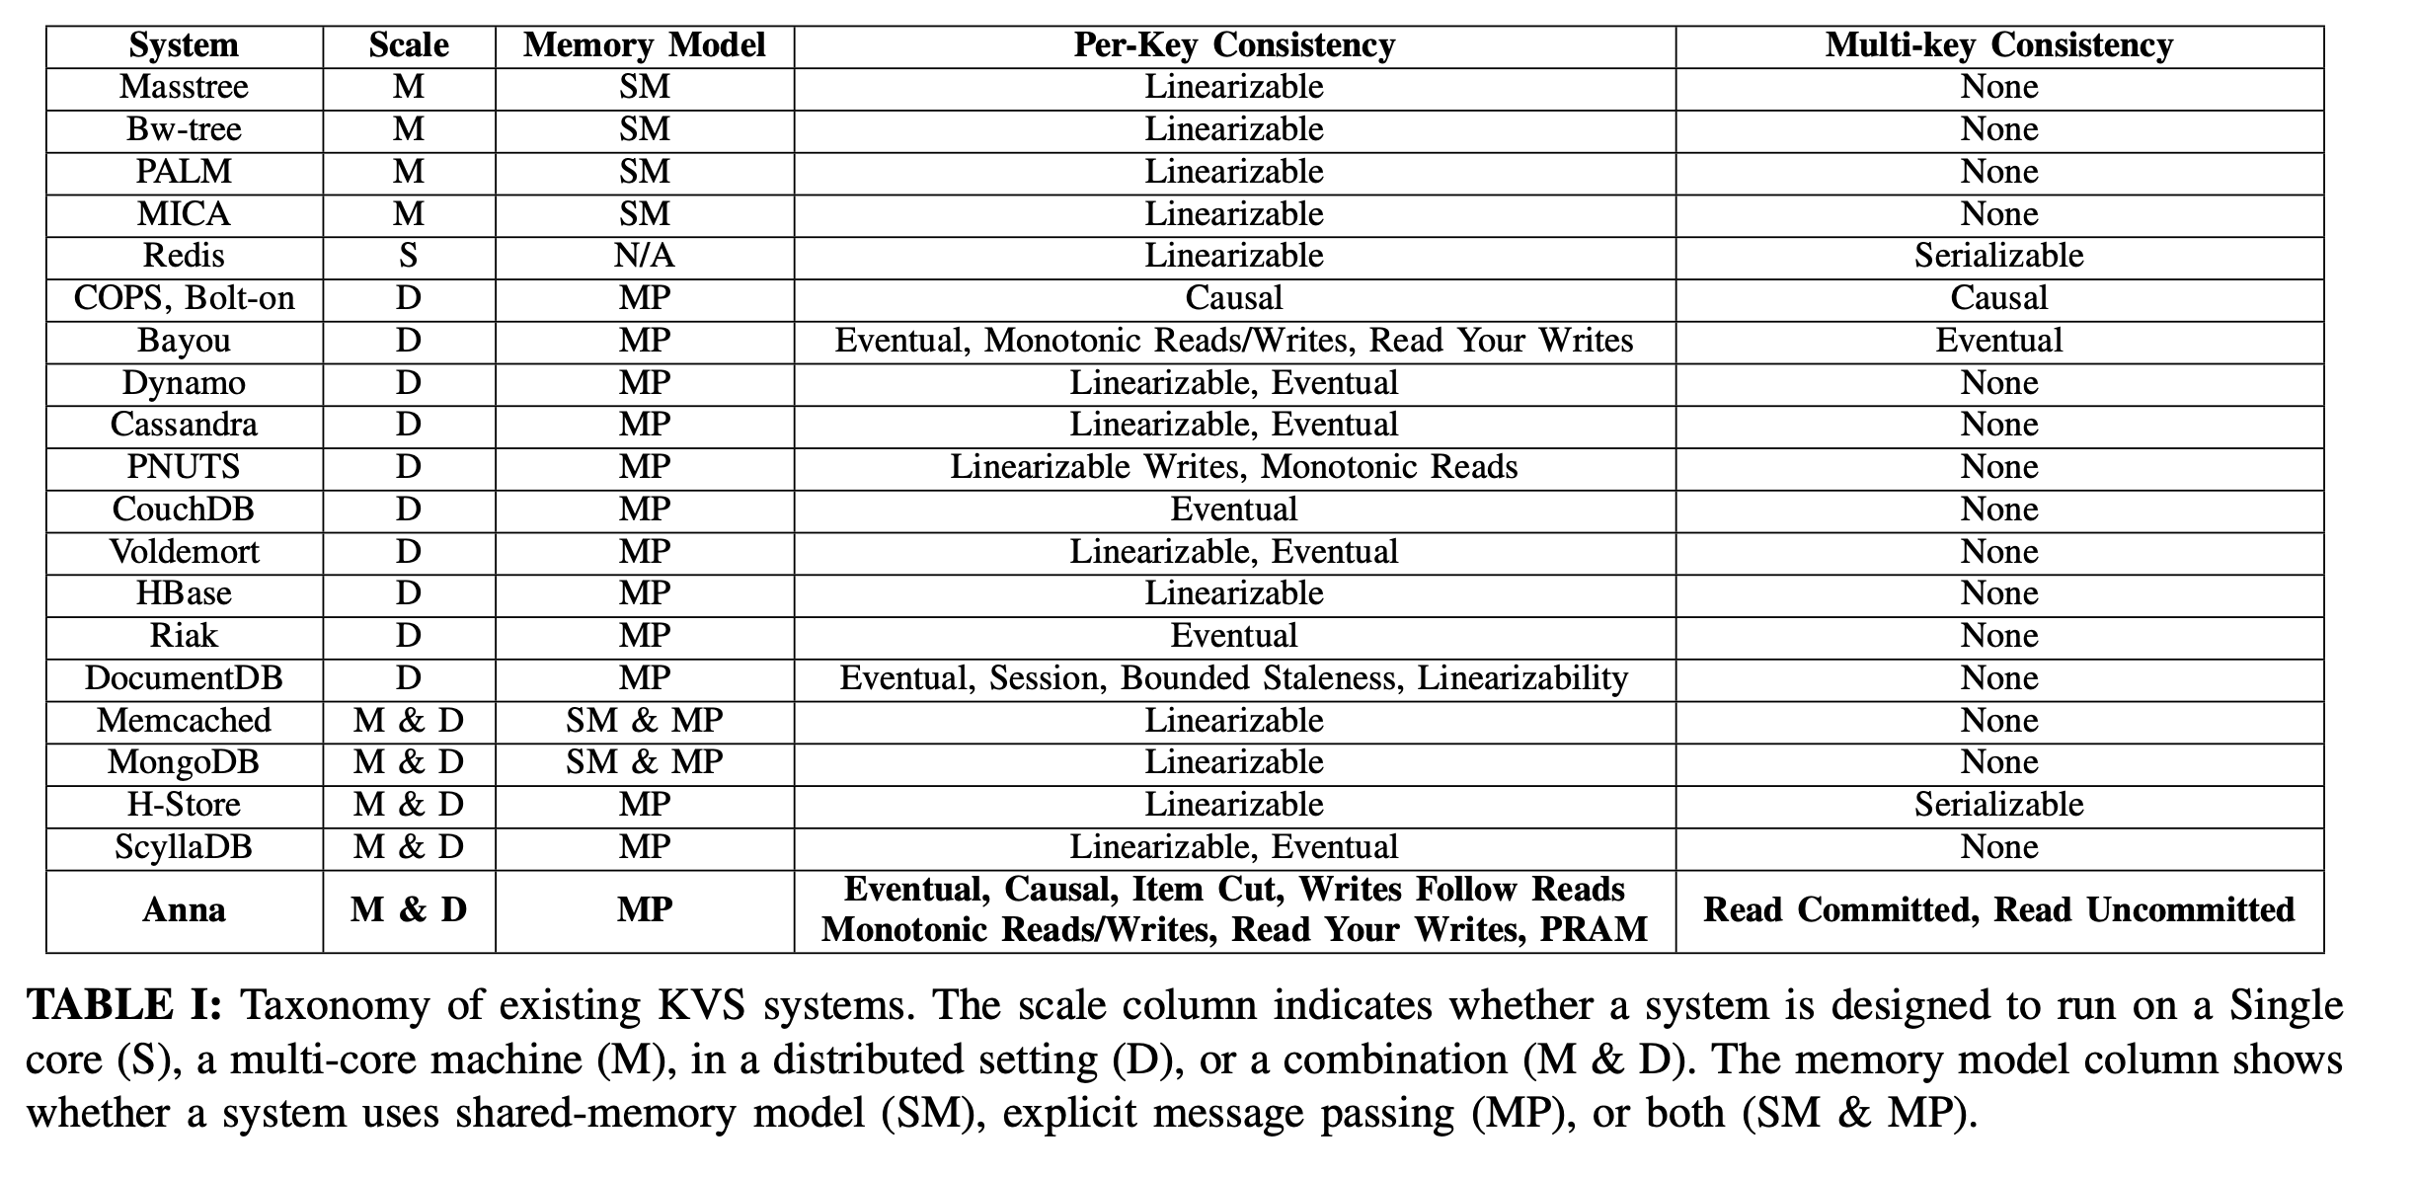
latency autoscaling key-value store designed to achieve a variety of coordination-free consistency levels by using mergeable mono- tonic lattice data structures
https://github.com/hydro-project/anna
“Anna: A KVS For Any Scale”

Slide 36
Both function and data move

